Slide 1
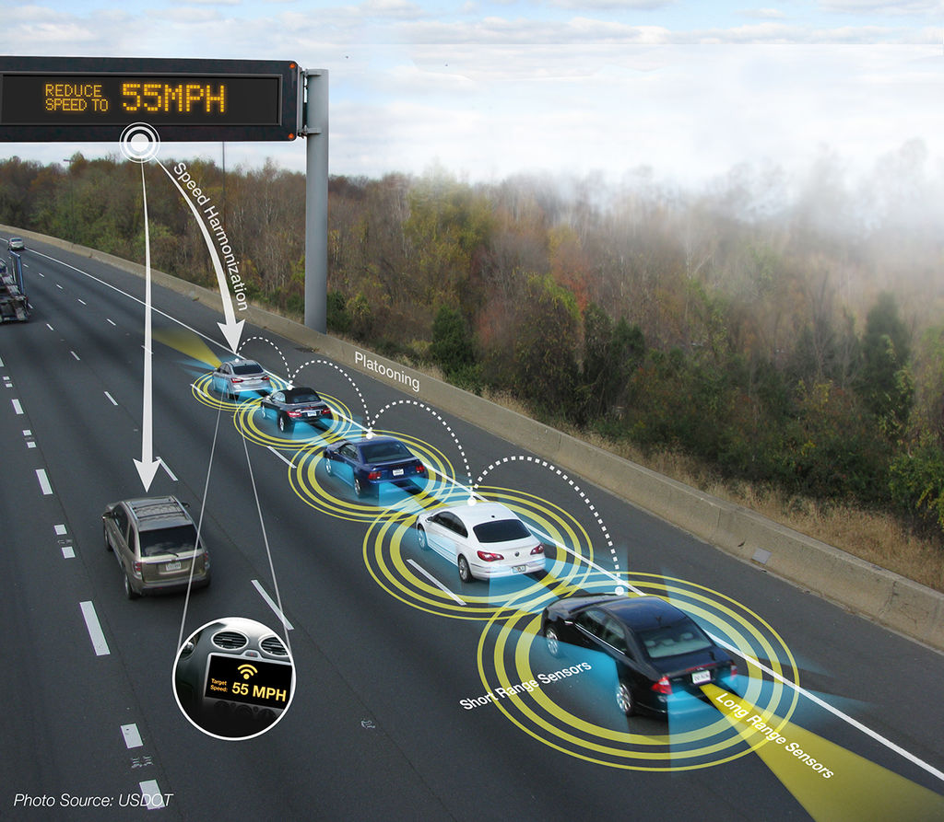
Fuzzy Logic Longitudinal Controller
Heath Palmer
Notes:
Source: https://en.wikipedia.org/wiki/Platoon_(automobile)

Slide 2
Progress Update
Tested the fuzzy logic controller with data output from SUMO
Implemented the fuzzy logic longitudinal controller in SUMO real-time

Slide 3
SUMO – FIS Controlled Vehicles
The Fuzzy inference system (FIS) is implemented after 60-time steps into the SUMO simulation.
Vehicle 0 is using the human driving model the entire time. Vehicles 1-4 use the longitudinal FIS after time step 60.
The inclusion of the FIS slows down the simulation considerably.
The current hand-picked membership functions and rules appear to perform like the human driving model (Krauss model) with some decrease in the gap distance.

Slide 4
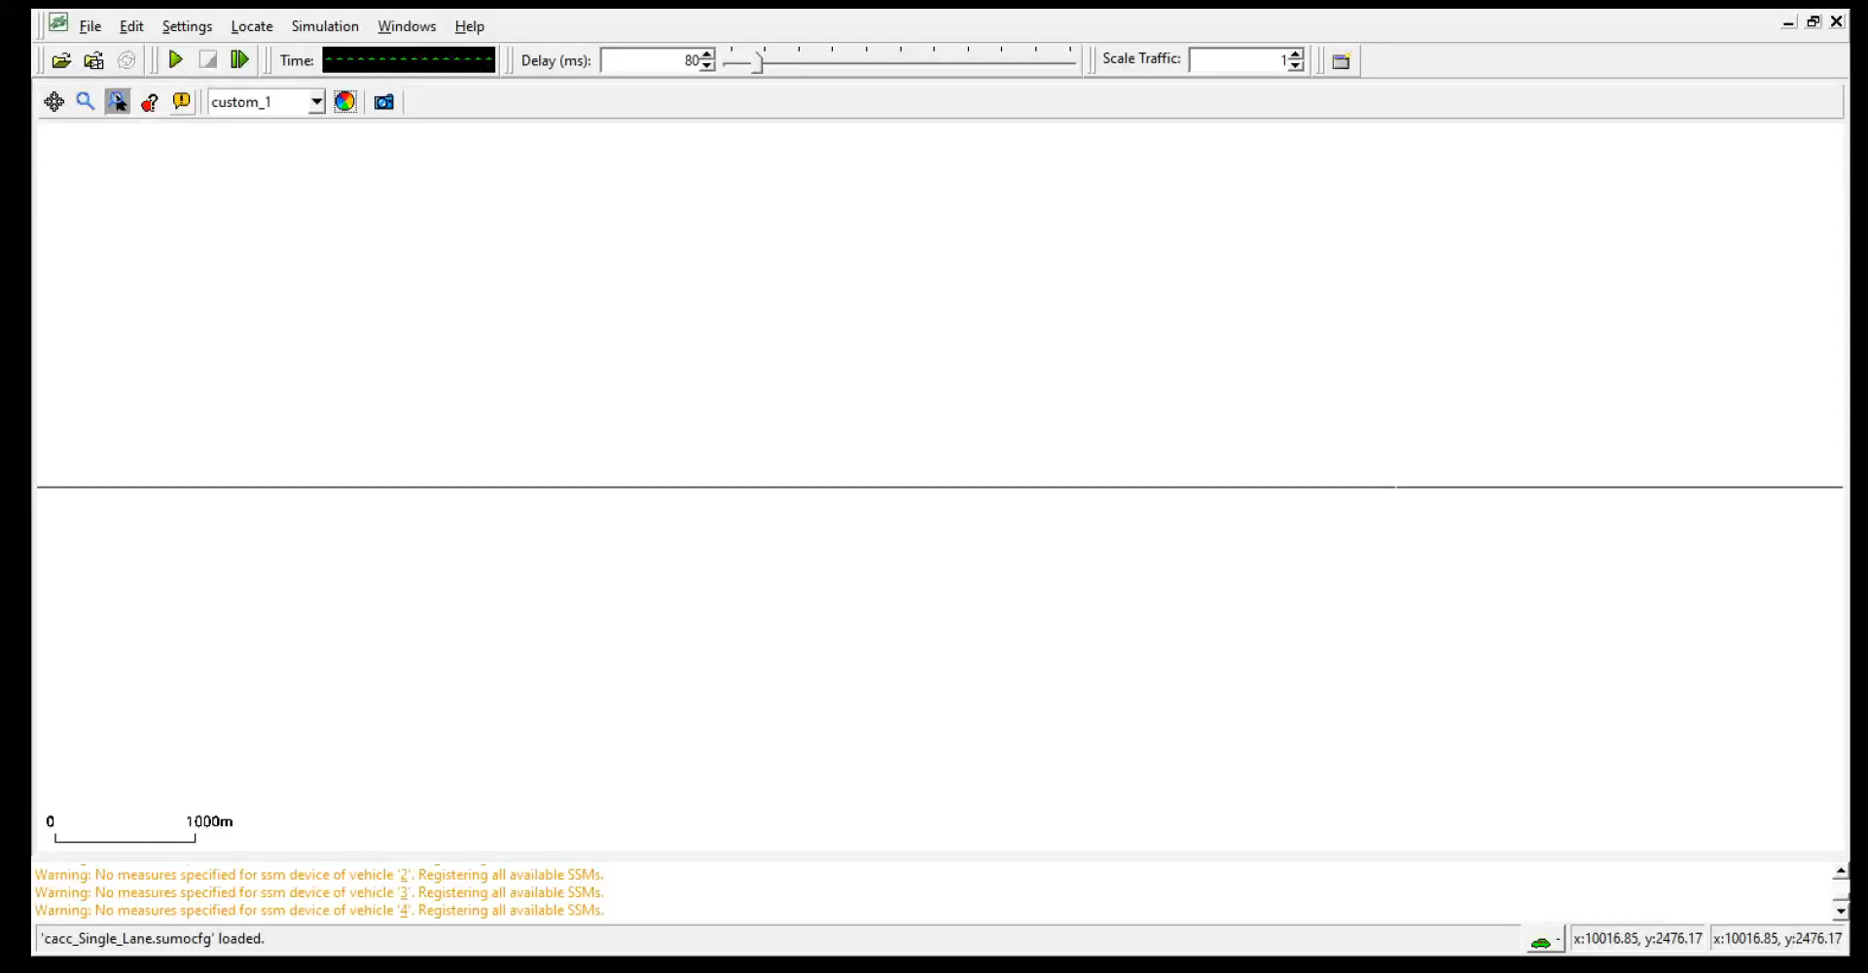
SUMO – FIS Controlled Vehicles

Slide 5
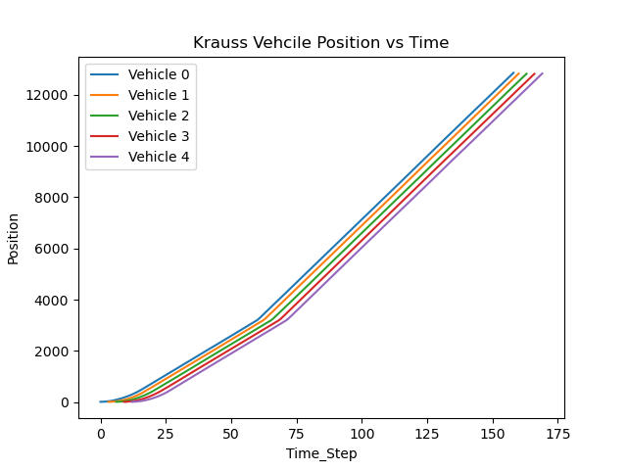
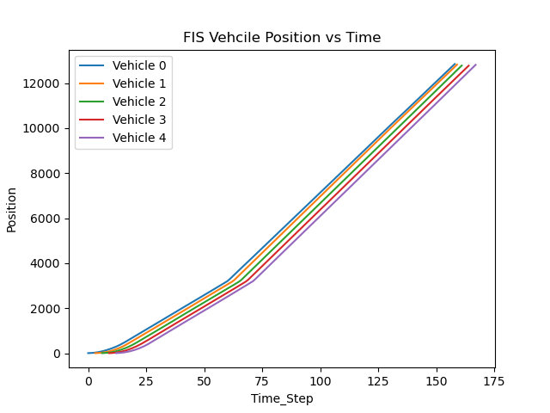
Krauss vs FIS – Position (meters)
Review the position after time step 60.

Slide 6
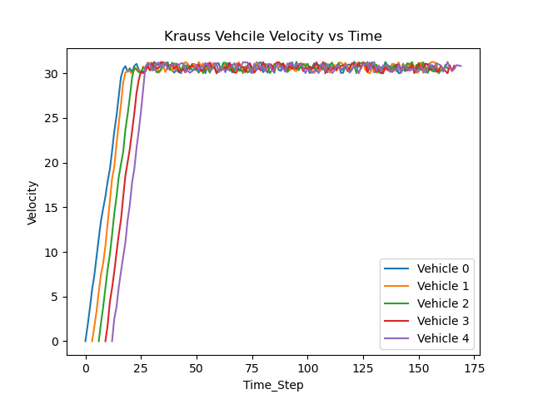
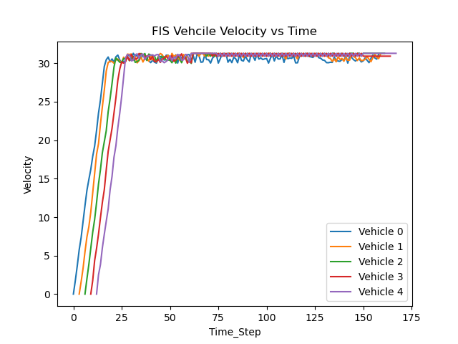
Krauss vs FIS – Velocity (m/s)
Review the velocity after time step 60.

Slide 7
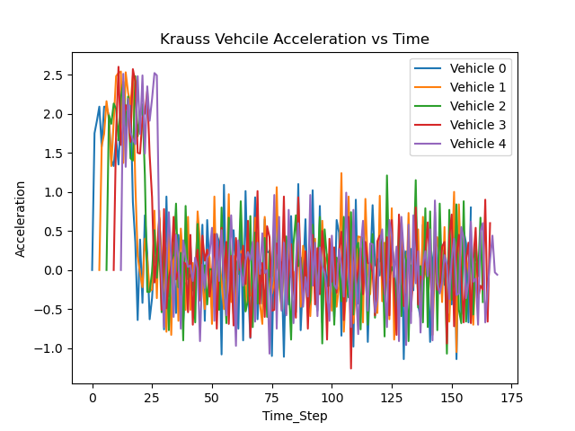
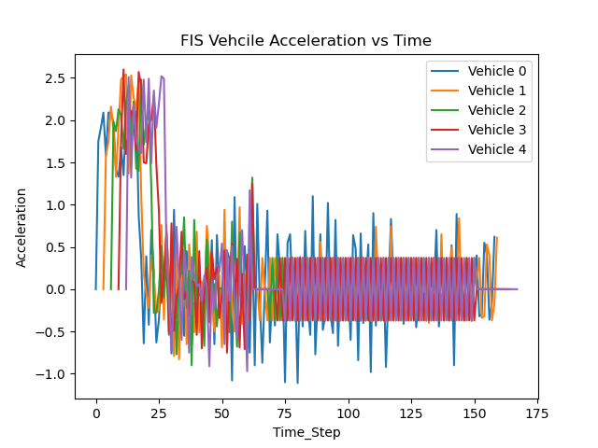
Krauss vs FIS – Acceleration (m/s^2)
Review the acceleration after time step 60.

Slide 8
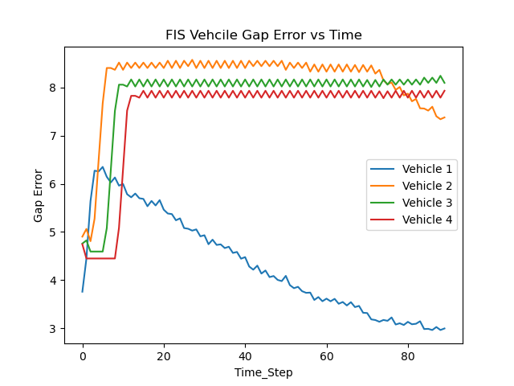
FIS Gap Error (seconds)
The ideal gap is 1 second.
The gap error is the: ego vehicle gap – ideal gap
The best gap error is closest to 0. The hand-picked membership functions and rules require tuning.

Slide 9
Immediate Next Steps
Implement a genetic algorithm to tune the FL controller

Slide 10
Appendix

Slide 11
Motivation behind the effort. Why Fuzzy?
Motivation behind the effort:
In transportation, platooning is a method for driving a group of vehicles together. It is meant to increase the capacity of roads via an automated highway system.
The development of a quick to respond vehicle longitudinal controller is necessary to ensure safety on the road. Automated vehicles have a high level of space co-occupation with its user. The user will have a low to moderate engagement with the automated vehicle when engaging with the vehicle.
If the prediction model is not well trained and unexplainably fails to accurately control the vehicle, the passengers could be put into danger and lose trust in the vehicle's automated driving.
Why Fuzzy:
Fuzzy logic is more explainable than artificial neural networks (ANN). Including a more explainable classification method could help build trust in the interaction with the automated vehicle.
This fuzzy logic controller will be optimized using a genetic algorithm (GA). Such systems are optimized quicker than a developer can manually achieve based on experience.

Slide 12
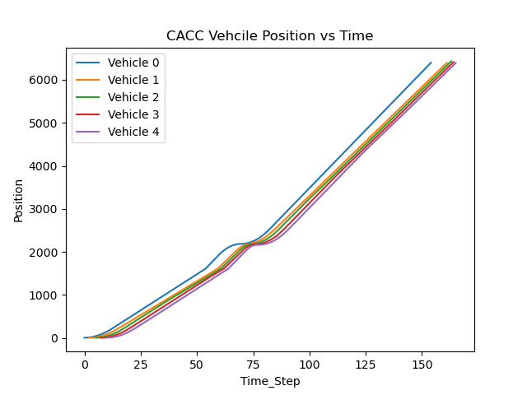
Source of Data
The data sourced from SUMO while the simulation is running.
The gap distance error and the rate that changes will be calculated and used as inputs to the fuzzy system.
The data will be sampled during each time step in SUMO.
The position values recorded by SUMO over time are evaluated.

Slide 13
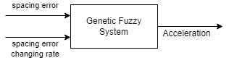
Block Diagram Describing System
The genetic fuzzy system is run before passing on the acceleration value to each vehicle.
The fitness value is calculated after the SUMO simulation completes.

Slide 14
Input/Output Membership Functions
The two inputs to the GFS will be paired based on the values mentioned in the publication.
Membership functions will be triangles for both the input and output.
The user may tune the number of membership functions there will be per input and output.
The GA will optimize the left and right edges alongside the peak location of each membership triangle. The edges and peak location per membership function will be genes in the GA chromosome. The triangles may end up as isosceles or scalene triangles.
The input membership functions accommodate
The error in the gap distance between the ego vehicle and the proceeding vehicle.
The gap error changing rate.
The output membership function is the acceleration value the vehicle will act on.

Slide 15
Fuzzy Rule Base, Inference Method, Defuzification
Rule Base | The rule base for the genetic fuzzy system is tuned using the genetic algorithm. A Pittsburgh approach will be used to develop a part of the genetic algorithm chromosome. This chromosome includes genes to define the rule base. The rules will use AND operations. The number of rules are based on the decision table with two inputs and one output. I plan to use 30 rules per FIS.
Inference Method | A Mamdani Fuzzy Inference system will be used.
Defuzification | Each output membership function are triangles. The center of mass method is used when defuzzifying an output per FIS.
Notes:
https://sci2s.ugr.es/keel/pdf/specific/articulo/scopus30.pdf

Slide 16
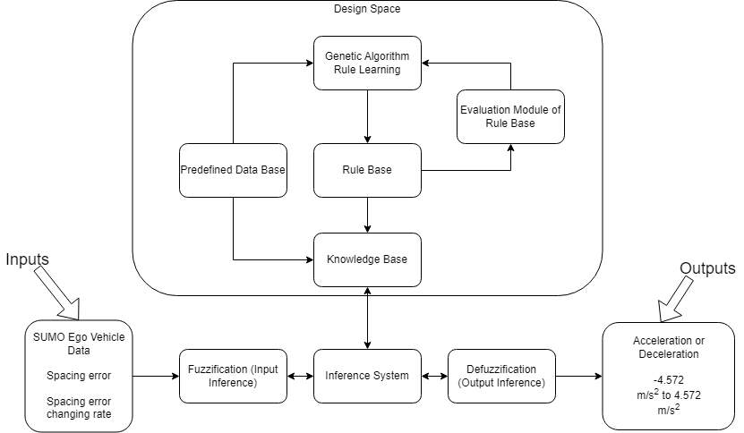
Fine tuning approach
The fuzzy system uses a genetic algorithm that tunes the rule base.
The fitness function will be the sum of the gap error over the SUMO simulation between time step 120 and 240.
This allows for the vehicles to reach max speed and settle in line before evaluation.

Slide 17
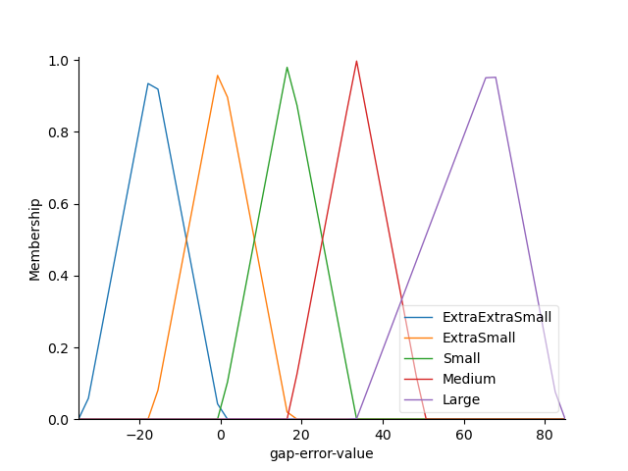
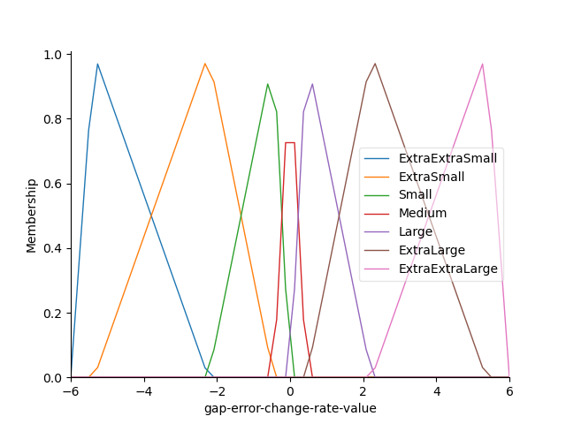
Preliminary Membership Functions
Plot of the input membership functions
Gap error = actual spacing – desired spacing
Units: meters
Units: m/s
Notes:
The graphs look off because of the way I initialized the fuzzy variables and their space. Used numpy linspace between a range. The values generated for each membership function are not exactly the same as the values chosen for the membership boundaries.

Slide 18
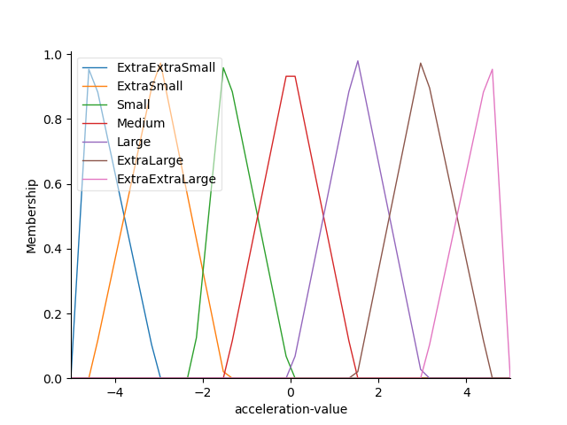
Preliminary Membership Functions
Plot of the output membership function
Units: m/s²

Slide 19
Immediate Next Steps
Test the fuzzy logic controller with data output from SUMO
Implement the fuzzy logic longitudinal controller in SUMO real-time
Implement a genetic algorithm to tune the FL controller

Slide 20
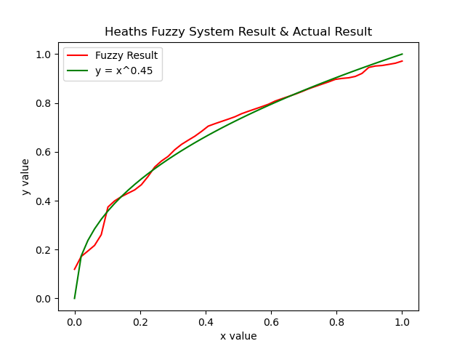
HW 3 – SciKit Fuzzy
Using my input and output membership functions and rule sets, I recreated the results below.

Slide 21
Activity Report
Saving vehicle data after the simulation runs.
The data is pulled from the XML output files SUMO generates.
Including vehicle:
Position
Velocity
Acceleration
Using the Flake8 linter to check code style, syntax, and complexity.

Slide 22
SUMO – Collecting Data
Collect vehicle data at the end of each simulation.
Planning to use this data as input into the platooning controller.

Slide 23
SUMO Position Data

Slide 24
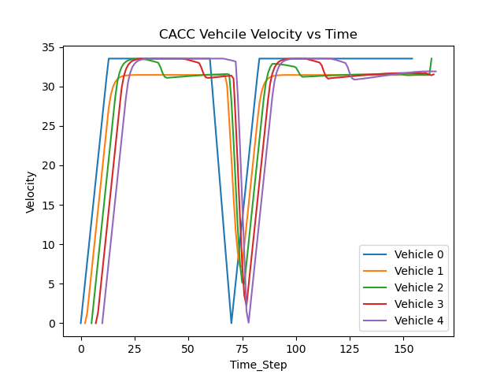
SUMO Velocity Data

Slide 25
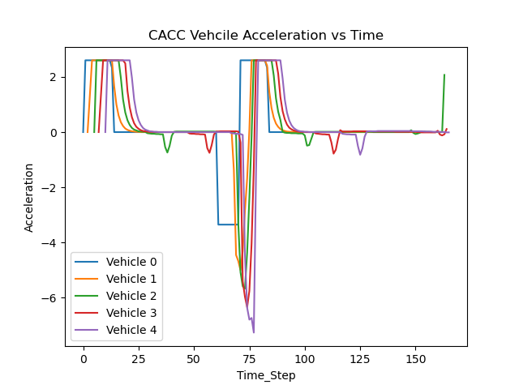
SUMO Acceleration Data

Slide 26
Flake8
Flake8 is a Python library that wraps PyFlakes, pycodestyle and Ned Batchelder's McCabe script.
It is a great toolkit for checking your code base against coding style (PEP8), programming errors.
https://flake8.pycqa.org/en/latest/

Slide 27
Situational/Risk Assessment and Timeline to converge
I believe I am roughly 15% complete with this project.
I have created a script to calculated the RMS of the EMG data. This should remain constand moving forward.
The genetic fuzzy tree is not working as desired. The flow of the system shall be changed based on discussion with Lynn.
I plan to change one thing at a time. Changing more things at once has and will result in confusion.
I have discussed my concerns with Lynn and will continue to stay connected as I make changes.
After discussion with Lynn, I feel more comfortable making changes to my system.
The expected accuracy of the system is 85-90%.

Slide 28
Fuzzy Reflections
The initial review and visualization of the data is very important. I thought I had a grip on it until I began running it through the fuzzy system. I plan to visualize the data and review that in more detail. Some sort of clustering may be used during the review of the data to help determine input pairs and any relationships between inputs and outputs.
The way I applied a genetic algorithm may work, but it is not efficient for my system. Currently, I am optimizing each fuzzy system separately using genetic algorithms for each FIS. This may optimize each FIS but does not optimize the fuzzy tree. I shall save what I have and re-structure when the GA tuning occurs.

